Slide 1
Object Detector Using Python
Information technology
Done by:
Amala mahalakshmi p
Evelyn beatrice a
Charulatha n

Slide 2
Introduction
Humans can easily detect and identify objects present in an image or in front of them. The human visual system is fast and accurate and can perform complex tasks like identifying multiple objects and detecting obstacles with little conscious thought. With the availability of large amounts of data, faster GPUs, and better algorithms, we can now easily train computers to detect and classify multiple objects within an image with high accuracy.

Slide 3

WHAT IS OPENCV ?

Slide 4

OpenCV
OpenCV is the huge open-source library for computer vision, machine learning, and image processing and now it plays a major role in real-time operation which is very important in today’s systems. By using it, one can process images and videos to identify objects, faces, or even the handwriting of a human. This article focuses on detecting objects.

Slide 5
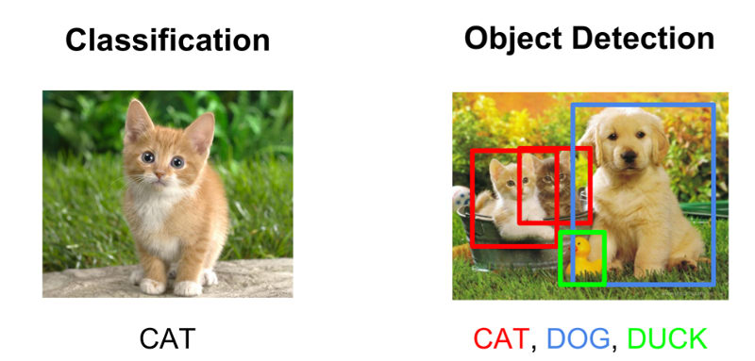
Classification
Object Recognition
Object identification object detection

Slide 6
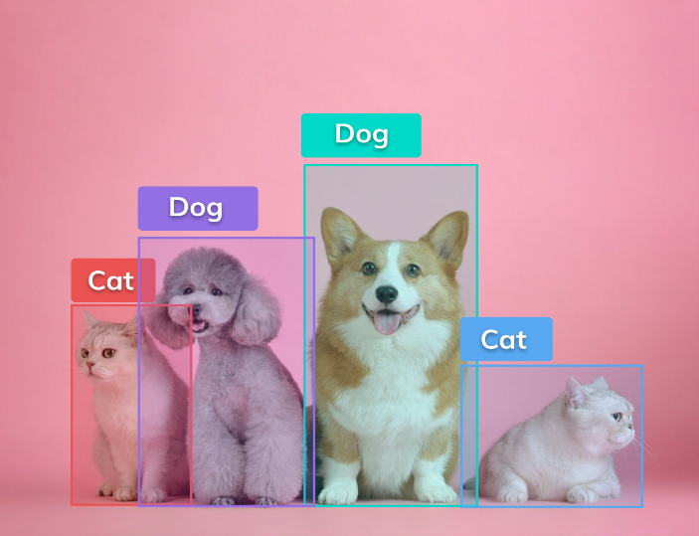
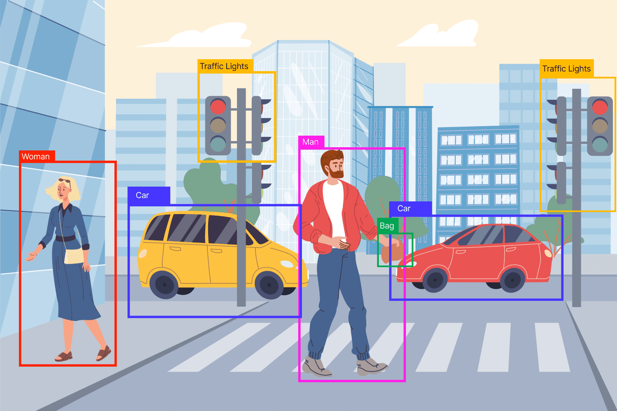
What is Object detection?
Object detection is the process of locating objects with bounding boxes in an image or a video. It is one of the most important tasks in computer vision, and it has many applications in various fields such as surveillance, people counting, traffic monitoring, detecting pedestrians, self-driving cars, etc.

Slide 7

How object detection different from image classification?
Object detection is different from image classification: Object detection is the process that identifies or locates objects in an image while image classification is the process that assigns labels (classes) to images based on their content.

Slide 8
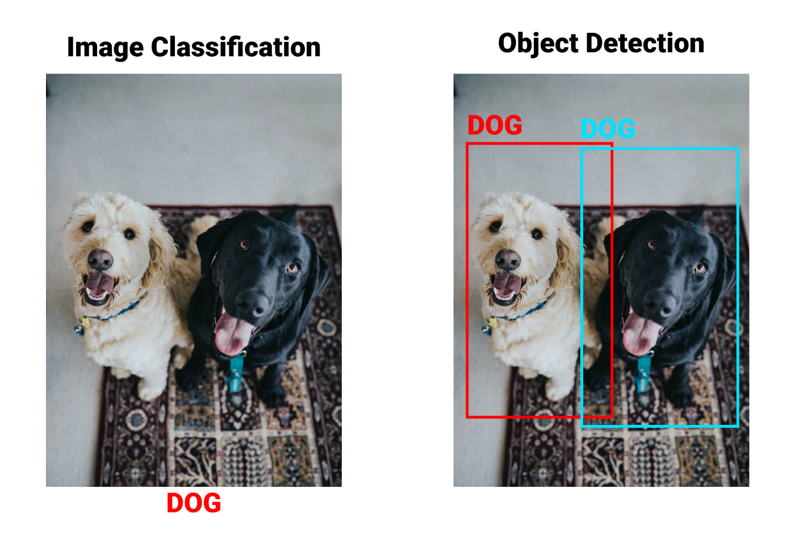
Image classification and object detection

Slide 9
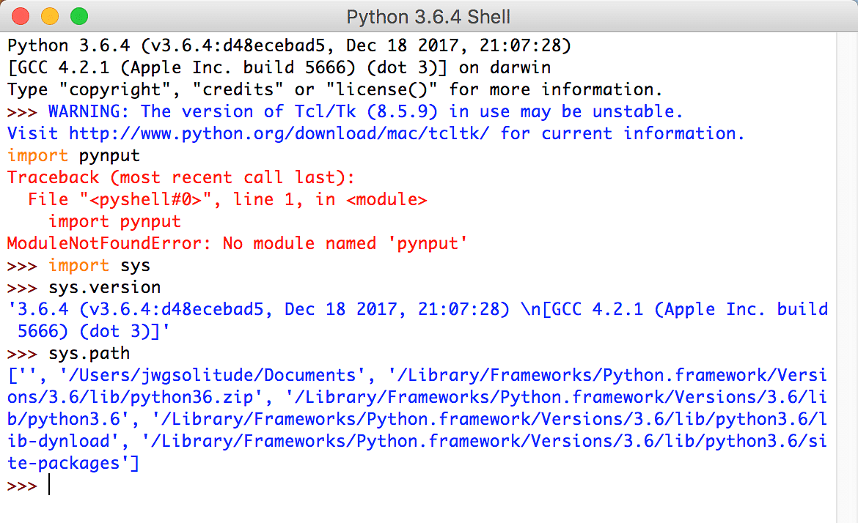
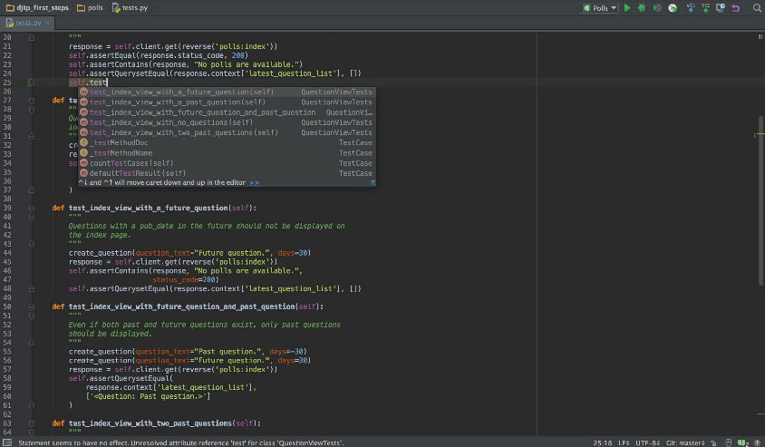
The Different platforms which can be used are:
IDLE
PyCharm

Slide 10
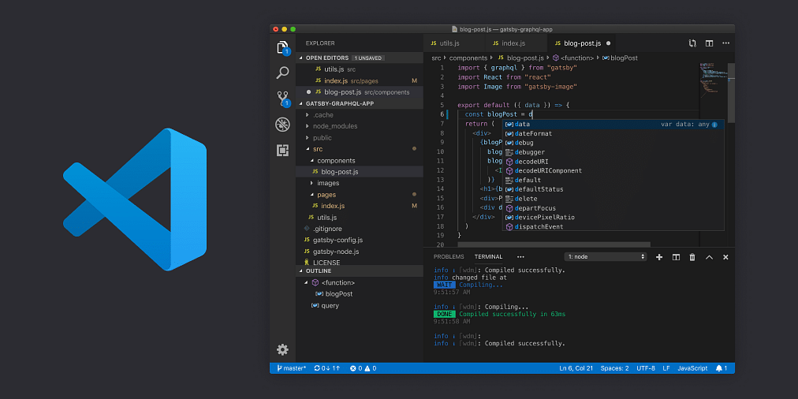
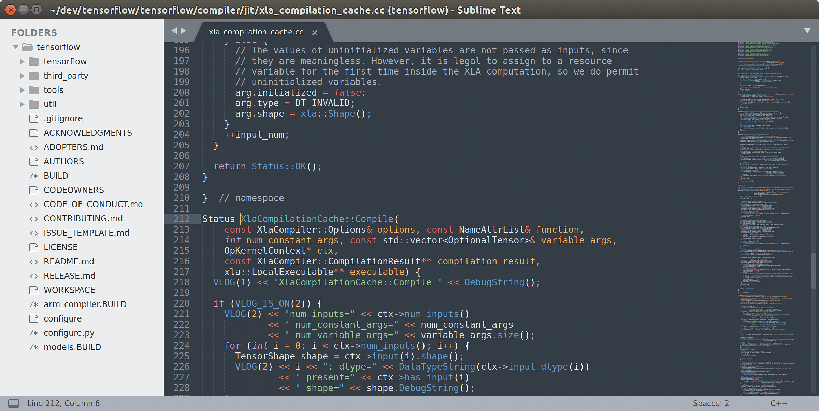
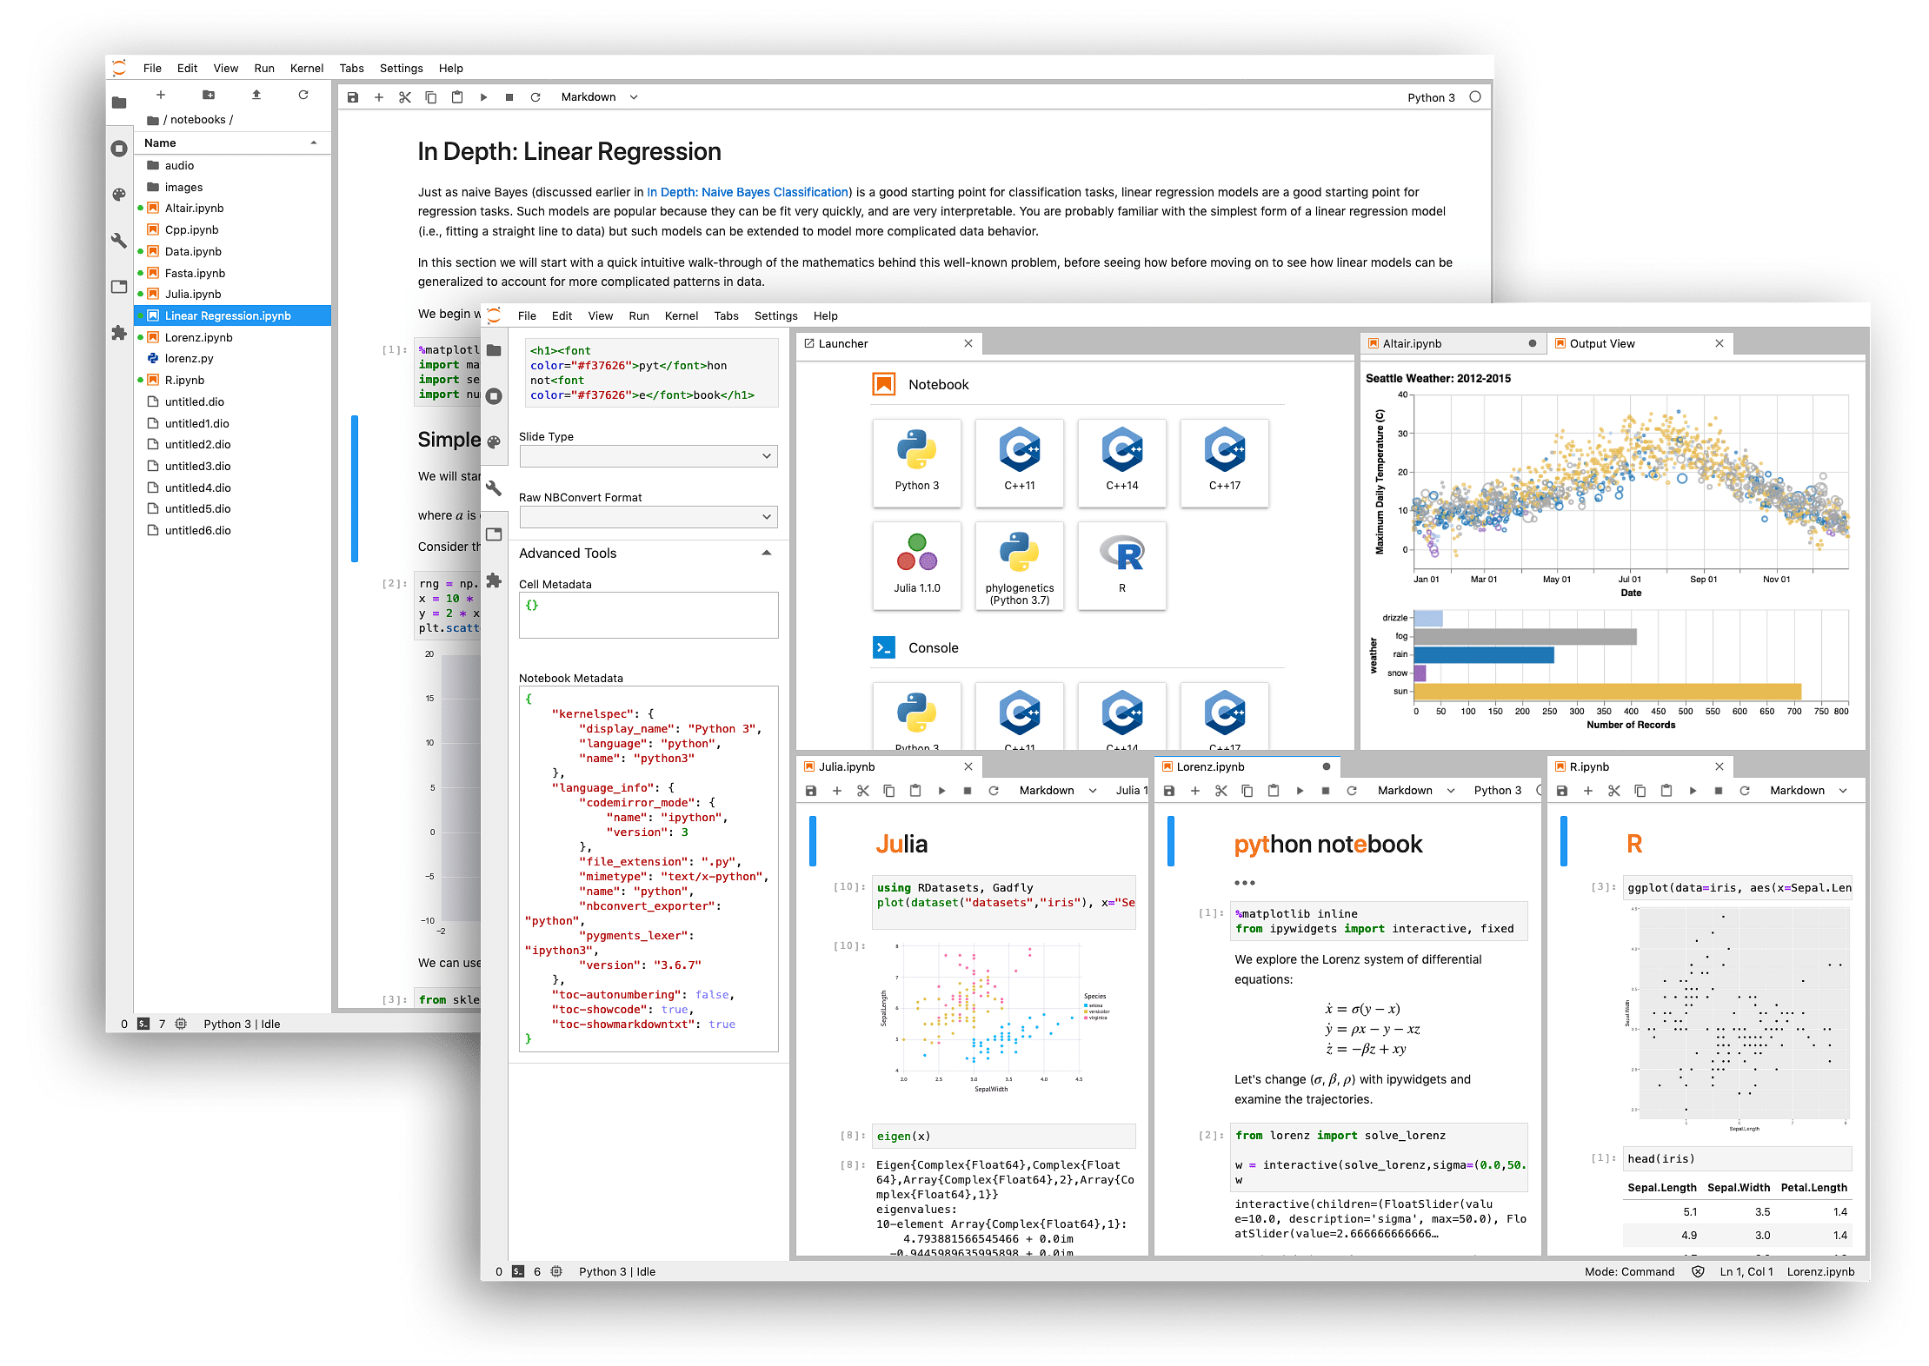
Visual Studio Code
Sublime Text 3
Jupyter

Slide 11
The software used by us is:
PyCharm
PyCharm is a widely used Python IDE created by JetBrains
This IDE is suitable for professional developers and facilitates the development of large Python projects
Smart code navigation
Quick and safe code refactoring
Support features like accessing databases directly from the IDE

Slide 12
CODE

Slide 13
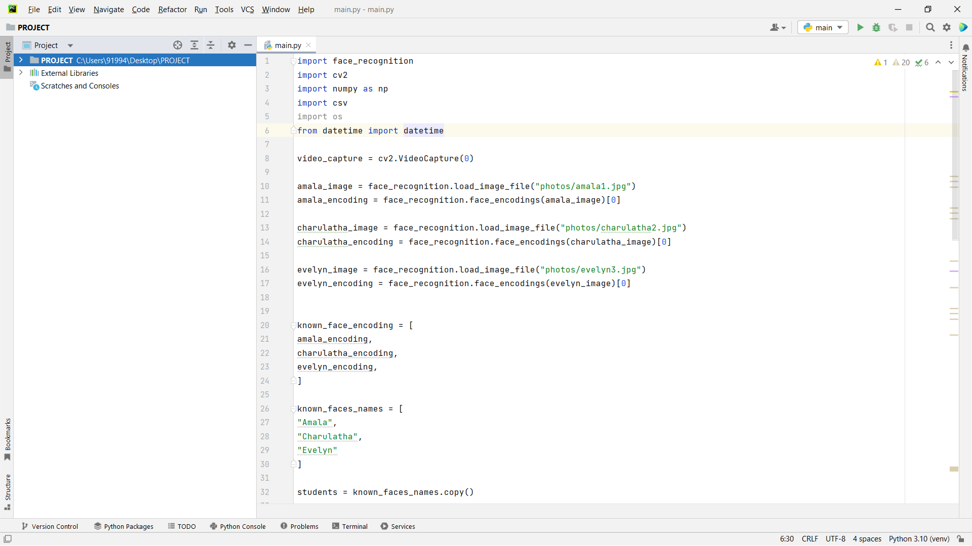

Slide 14
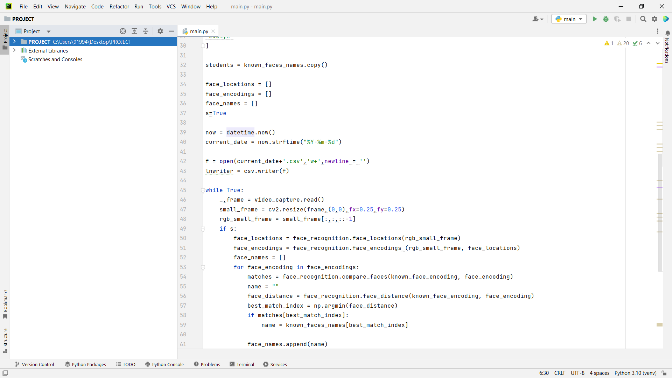

Slide 15
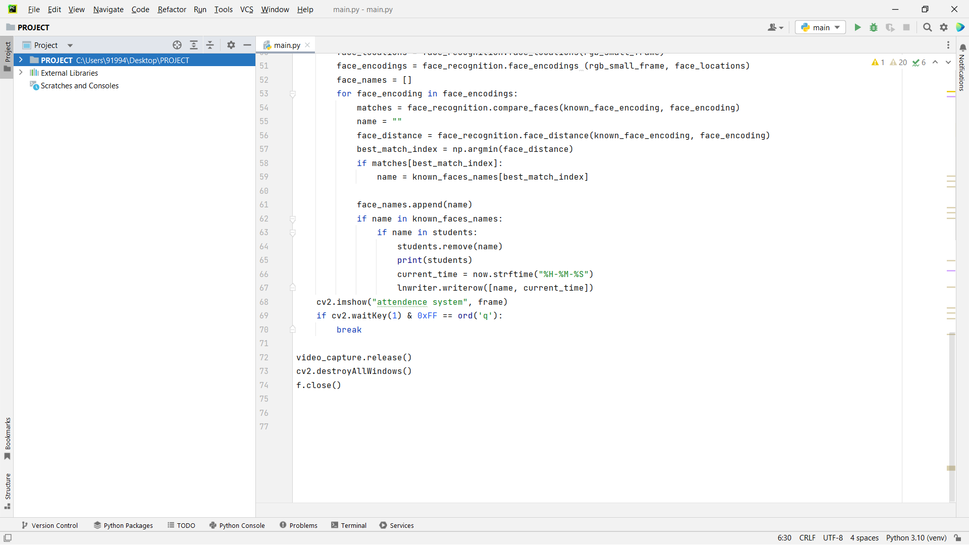

Slide 16
THANK YOU

